Slide 1


SIGN LANGUAGE CLASSIFICATION
Machine Learning for Robotics II
A.Y. 2022-2023
Claudio Del Gaizo (s4696649)
Thomas Campagnolo (s5343274)
Notes:
Thomas

Slide 2
SCENARIO
Deaf-mute people often face challenges in social interaction due to language barriers.
Machine learning and classification techniques can be used to train social robots to recognize gestures and sign language expressions.
Improves:
Flexible communication
Accessibility
Reduction of social isolation
2
Notes:
Thomas

Slide 3
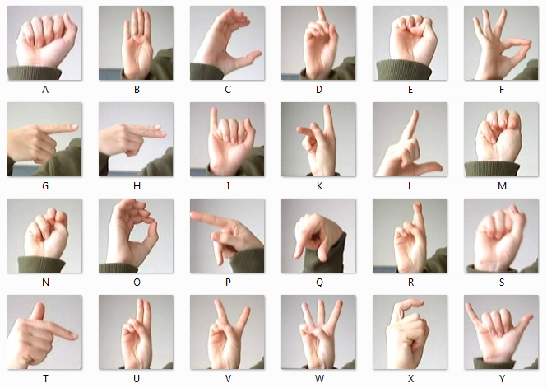
ORIGINAL DATASET
Training set (27455 samples)
Test set (7172 samples)
Label 0-25 mapped A-Z
No instances of J (9) & Z (25) due to gesture movements.
Data structures:
Label | pixel1 | pixel2 | … | pixel784
…
…
representing a single image of 28x28 pixels with grayscale values 0-255
Sign Language MNIST Dataset [1]
3
Notes:
Thomas

Slide 4
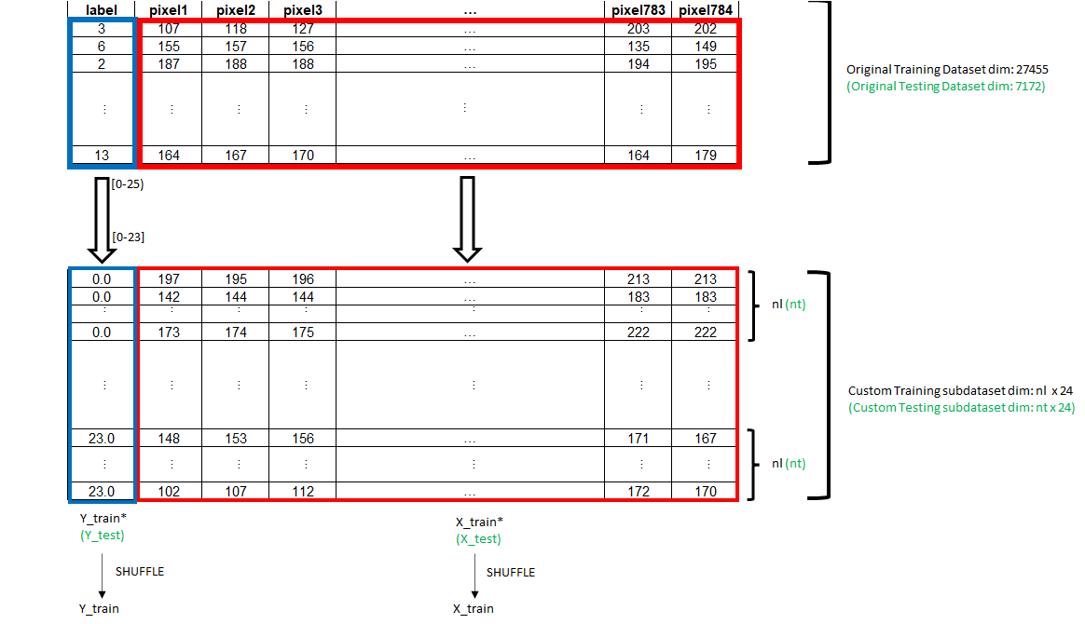
CUSTOM SUB-DATASET
(for Machine Learning approach)
4
Notes:
Thomas

Slide 5
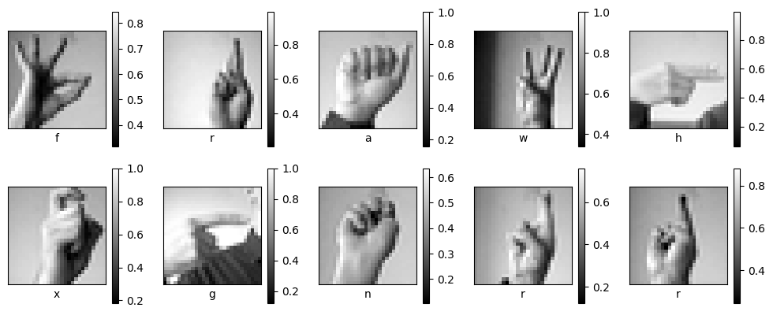
PREPROCESSING & DATA VISUALIZATION
Standard Scaler: MinMaxScaler mapping [0-255] → [0-1]
10 random images with related labels (classes) from custom training subset:
5
Notes:
Thomas

Slide 6
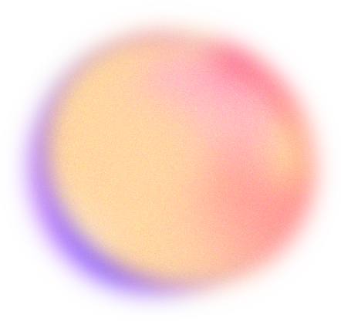
CLASSIFICATION MODELS
Support Vector Machines - SVC
Support Vector Machines - LinearSVC
Linear and Gaussian (rbf) kernels
Random Forest
The estimators are chosen following the
scikit-learn guide [2]
6
Notes:
Claudio

Slide 7
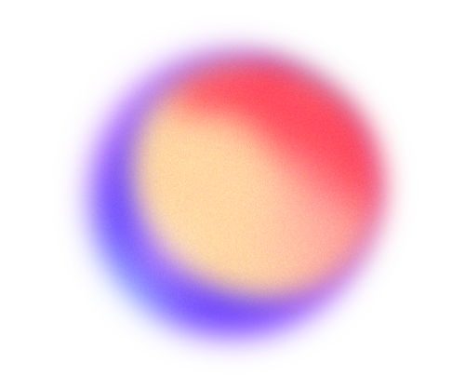
SVC – Support Vector Classifier
[3]
HYPERPARAMETERS
DECISION APPROACH
C: regularization parameter
Kernel: [linear, rbf]
γ: kernel coefficient for rbf (regulate the non linearity of the model)
One – vs – One
Majority voting
7
Notes:
Claudio

Slide 8
LinearSVC
[4]
HYPERPARAMETERS
DECISION APPROACH
C: regularization parameter
loss: Hinge, standard SVM loss, squared_hinge (default)
penalty: l2, standard used in SVC (norm2)
One – vs – Rest
Signed distances from the hyperplanes
8
Notes:
Claudio

Slide 9
GridSearchCV
GRID
Previously described hyperparameters (e.g. C: logspace(-4,3,5), kernel: [linear, rbf], …)
CROSS-VALIDATION
Splitting strategy, based on Stratified K-folds (e.g. cv = 10)
SCORING
Strategy to evaluate the performance of the cross-validated model on the test set (e.g. scoring = ‘accuracy’)
9
Notes:
Claudio

Slide 10
Random Forest
[6]
HYPERPARAMETERS
PARAMETERS
-
n_estimators: number of trees in the forest (boosting)
(e.g. 1000)
max_features: number of features to sample in each node (bagging) (“sqrt”, default)
10
Notes:
Claudio

Slide 11
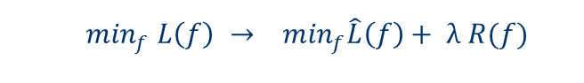
MINIMIZATION PROBLEM
$$\min_{f} L\left(f\right) → \min_{f}\hat{L}\left(f\right)+ λ R(f)$$
 | LOSS FUNCTION | λ | REGULARIZER
SVC | Hinge loss | C | norm2
LinearSVC | Hinge loss / squared_hinge | C | norm2 / norm1
Random Forest | Gini loss (0-1 loss) | implicit | implicit
11
Notes:
Thomas

Slide 12
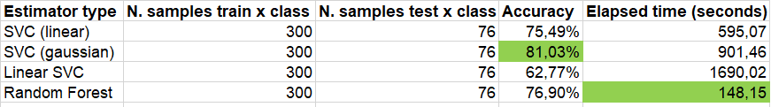
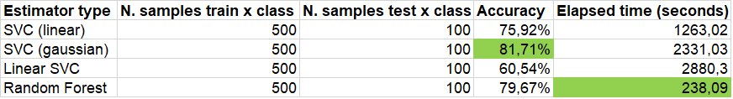
RESULTS
Custom training subdataset: 7200 images
Custom testing subdataset: 1824 images
Custom training subdataset: 12000 images
Custom testing subdataset: 2400 images
12
Notes:
Thomas

Slide 13
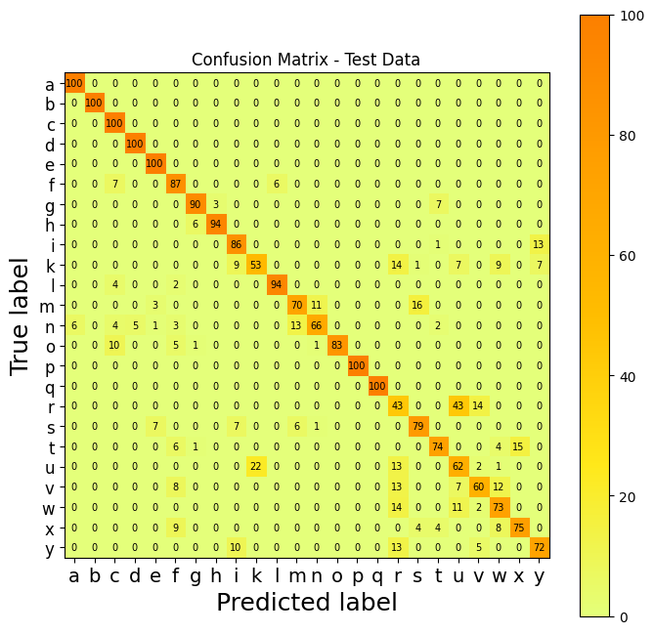
CONFUSION MATRIX
SVC, Gaussian kernel
Optimal parameters:
C: 17,782
Gamma: scale
Kernel: rbf (gaussian)
13
Notes:
Claudio

Slide 14
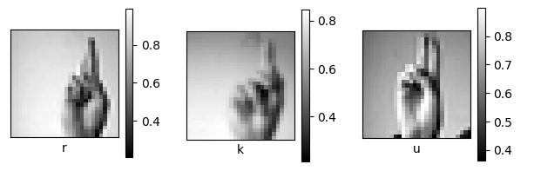
CONFUSION MATRIX
R, K and U → lower correspondence values
14
Notes:
Claudio

Slide 15
CONCLUSION & POSSIBLE IMPROVEMENTS
The SVC classification model (gaussian kernel) manages to solve this sign language classification problem with discrete results.
Deep Learning can improve the performances in this specific task, thanks to:
Learning a better representation of data (instead of fixed);
Automatic extraction of relevant features from images with Convolutional Neural Networks (CNN);
Robustness to variations → lighting, hand position and factors that can affect the images.
15
Notes:
Claudio

Slide 16
THANKS FOR THE ATTENTION!
DO YOU HAVE ANY QUESTIONS?

Slide 17
REFERENCES
[1] Dataset Sign Language MNIST:
https://www.kaggle.com/datasets/datamunge/sign-language-mnist
[2] Scikit-Learn estimator guide:
https://scikit-learn.org/stable/tutorial/machine_learning_map/index.html
[3] Scikit-Learn, SVM (SVC):
https://scikit-learn.org/stable/modules/generated/sklearn.svm.SVC.html#sklearn.svm.SVC
[4] Scikit-Learn, SVM (LinearSVC):
https://scikit-learn.org/stable/modules/generated/sklearn.svm.LinearSVC.html#sklearn.svm.LinearSVC
[5] Scikit-Learn, model selection GridSearchCV:
https://scikit-learn.org/stable/modules/generated/sklearn.model_selection.GridSearchCV.html#sklearn.model_selection.GridSearchCV
[6] Scikit-Learn, Random Forest:
https://scikit-learn.org/stable/modules/generated/sklearn.ensemble.RandomForestClassifier.html#sklearn.ensemble.RandomForestClassifier
GitHub repository: https://github.com/thomascampagnolo97/sign_language_ML.git
17

